Slide 1
Naming conventions and Datatypes
In java

Slide 2
JVM
JVM (Java Virtual Machine) is an abstract machine. It is a
specification that provides runtime environment in which java
Byte code can be executed.
JVMs are available for many hardware and software platforms.
JVM, JRE and JDK are platform dependent because configuration
of each OS differs. But, Java is platform independent.
The JVM performs following main tasks:
Loads code
Verifies code
Executes code
Provides runtime environment

Slide 3
JRE
JRE is an acronym for Java Runtime Environment.It is used to
provide runtime environment.It is the implementation of JVM.
It physically exists.It contains set of libraries + other files that JVM
uses at runtime.
Implementation of JVMs are also actively released by other
companies besides Sun Micro Systems.

Slide 4
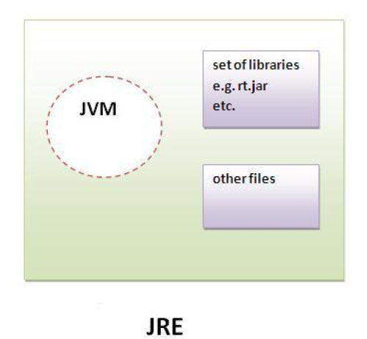
JRE

Slide 5
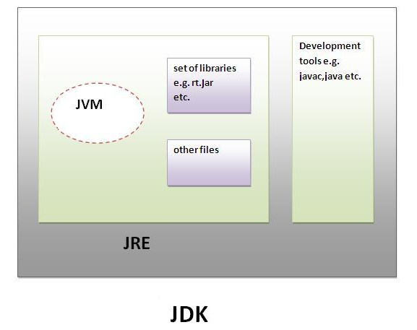
JDK ( Java Development KIT)
It physically exists.It contains JRE + development tools.

Slide 6
Naming Conventions
Specific rules to be followed by a java programmer while writing the names of packages, classes, methods, etc.
A package represents a sub directory that contains a group of classes and interfaces.
Small letters we need to represent:
java.io
java.swing
java.awt

Slide 7
A class is a model for creating objects. A class specifies properties and action of objects.
Both interface and class similar.
Each word of class and interface names starts with capital letter as :
String
DataInputStream
ActionListener

Slide 8
A class and interface contains methods
First word of a method names is in small letters then second word on wards, each new word starts with a capital letter as :
readLine()
get_Number_Instance()
Naming convention for variables is same as methods
age
empName
employee_Net_Sal
Note: if methods and variables having same rules then how to distinguish? Method ends with a pair of simple braces(), variable will not have.

Slide 9
Constants represent fixed values and we cant be changed or altered.
All are in capitals.
PI
MAX.VALUE
Font.BOLD
Here BOLD is a constant in Font class.
All keywords should be written by using small letters.
public
void
static

Slide 10
Data types
Based on the data type of a variable, the JVM allocates memory and decides what can be stored in the reserved memory. Therefore, by assigning different data types to variables, you can store integers, decimals, or characters in these variables.
There are two data types available in Java −
Primitive Data Types
Reference/Object Data Types or NON-primitive data types

Slide 11
Data types
Variable which represents a memory location which holds the data.
int x;
There are eight primitive data types.
Interger Data types:
These data types represent integer number, i,e numbers without any fractions or decimal
Ex: 125, -2256,0 etc.

Slide 12
Primitive Data type
There are eight primitive datatypes supported by Java. Primitive datatypes are predefined by the language and named by a keyword. Let us now look into the eight primitive data types in detail. https://docs.oracle.com/javase/tutorial/java/nutsandbolts/datatypes.html
byte
Byte data type is an 8-bit signed two's complement integer
Minimum value is -128 (-2^7)
Maximum value is 127 (inclusive)(2^7 -1)
Default value is 0
Byte data type is used to save space in large arrays, mainly in place of integers, since a byte is four times smaller than an integer.
Example: byte a = 100, byte b = -50
short
Short data type is a 16-bit signed two's complement integer
Minimum value is -32,768 (-2^15)
Maximum value is 32,767 (inclusive) (2^15 -1)
Short data type can also be used to save memory as byte data type. A short is 2 times smaller than an integer
Default value is 0.
Example: short s = 10000, short r = -20000

Slide 13
Interger data type
int
Int data type is a 32-bit signed two's complement integer.
Minimum value is - 2,147,483,648 (-2^31)
Maximum value is 2,147,483,647(inclusive) (2^31 -1)
Integer is generally used as the default data type for integral values unless there is a concern about memory.
The default value is 0
Example: int a = 100000, int b = -200000
long
Long data type is a 64-bit signed two's complement integer
Minimum value is -9,223,372,036,854,775,808(-2^63)
Maximum value is 9,223,372,036,854,775,807 (inclusive)(2^63 -1)
This type is used when a wider range than int is needed
Default value is 0L
Example: long a = 100000L, long b = -200000L
long x= 150L
If L is not given it allocates only two bytes . If L is there then it allocates 8 bytes.

Slide 14
Float data type
Float represents decimals: 3.14, 0.002,-123.11
float
Float data type is a single-precision 32-bit IEEE 754 floating point
Float is mainly used to save memory in large arrays of floating point numbers
Default value is 0.0f
Float data type is never used for precise values such as currency
Example: float f1 = 234.5f
double
double data type is a double-precision 64-bit IEEE 754 floating point
This data type is generally used as the default data type for decimal values, generally the default choice
Double data type should never be used for precise values such as currency
Default value is 0.0d
Example: double d1 = 123.4

Slide 15
Float
Precision : digits represents after accurately after decimal point.
Ex:float pi= 3.142F;
If F is not written at the end JVM assumes it is a double and allocated 8 bytes.
Reason is by default JVM take as double.
Interview question
What is the difference between float and double?
float represents upto 7 digits accurately after decimal point, where double can represents 15 digits.

Slide 16
Character data type
Char--- 2 bytes
char data type is a single 16-bit Unicode character
Minimum value is '\u0000' (or 0)
Maximum value is '\uffff' (or 65,535 inclusive)
Char data type is used to store any character
Example: char letterA = 'A'

Slide 17
Unicode system
What is unicode system?
Unicode system is an encoding standard that provides a unique number for every character, no matter what the platform, program or language is. Unicode uses 2 bytes to represent a single character.

Slide 18
unicode
Unicode | ASCII Character | ASCII Number
‘\u0030’ | ‘0’ | 48
‘\u0031’ | ‘1’ | 49
‘\u0041’ | ‘A’ | 65
‘\u0042’ | ‘B’ | 66
‘\u0061’ | ‘a’ | 97
‘\u0062’ | ‘b’ | 98

Slide 19
Boolean Data type
boolean data type represents any of two values true or false. JVM uses 1 bit to represent a boolean value internally.
Ex: boolean response = true.
We should not enclose the boolean value in any quotations.
****In C/C++ 0 represents false and any other number represents true. This is not valid in java.

Slide 20
Default values
Type | Default Value
byte | 0
short | 0
int | 0
long | 0
float | 0.0f
double | 0.0d
char | '\u0000'
boolean | false
String or other object | null

Slide 21
Non-primitive data types
Strings,
Arrays,
Classes,
Interface
Primitive types are predefined (already defined) in Java. Non-primitive types are created by the programmer and is not defined by Java (except for String).

Slide 22
How to find the size of a Primitive data type.
Java has no sizeOf operator like in c to find the size.
But all java primitive wrapper classes except Boolean provides the SIZE constants in bits that could be divided by 8 to get the size in bytes.

Slide 23
Size to find
class SizePrimitiveType
{
public static void main (String[] args)
{
System.out.println("Size of byte: " + (Byte.SIZE/8) + " bytes.");
System.out.println("Size of short: " + (Short.SIZE/8) + " bytes.");
System.out.println("Size of int: " + (Integer.SIZE/8) + " bytes.");
System.out.println("Size of long: " + (Long.SIZE/8) + " bytes.");
System.out.println("Size of char: " + (Character.SIZE/8) + " bytes.");
System.out.println("Size of float: " + (Float.SIZE/8) + " bytes.");
System.out.println("Size of double: " + (Double.SIZE/8) + " bytes.");
}
}

Slide 24
Literal
A literal represents a value that is stored into a variable directly in the program.
boolean result= false;
char gender=‘M’
short s =1000;
int i=-125;

